Slide 1
Graduate Record Exam

Slide 2
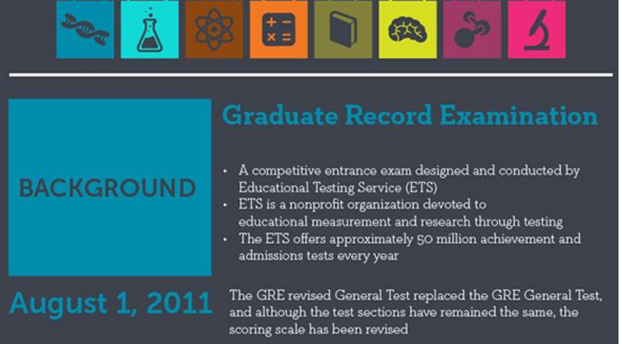
Overview of Proficiency Tests GRE IELTS TOEFL

Slide 3
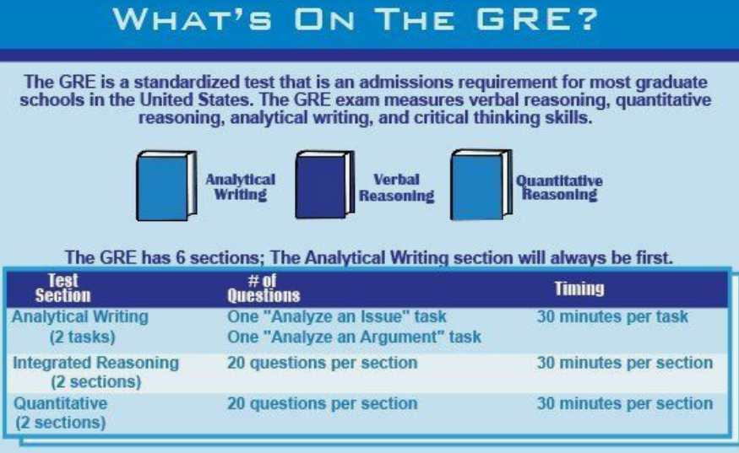

Slide 4


Slide 5
Verbal Reasoning
Analytical Writing
Comprehension: This section tests your ability to understand complex written passages, grasp main ideas and supporting arguments, and identify the author's perspective. You need strong reading comprehension skills to navigate dense academic texts and draw meaning from nuanced language.
Critical Thinking: Beyond simply understanding the text, you'll need to critically analyse it. This involves identifying assumptions, biases, and logical fallacies within the passage.
Reasoning from Incomplete Data: Real-world situations often present incomplete information. Can you make inferences and draw conclusions based on what's available, even if the picture isn't entirely clear?
Vocabulary and Relationships: A strong vocabulary is crucial, but it's not enough. You will need to understand how words and concepts relate to each other within sentences and paragraphs, recognizing synonyms, antonyms, and figurative language.
Critical Thinking: This section goes beyond memorizing facts or applying formulas. It tests your ability to analyse complex issues, identify strengths and weaknesses in arguments, and consider diverse perspectives. Can you break down a problem, see through biases, and form your own well-reasoned opinions?
Argument Construction: It's not enough to simply have an opinion. You need to be able to construct a persuasive argument, complete with a clear thesis statement, relevant evidence, and sound reasoning. Can you build a logically structured argument that effectively supports your position?
Clarity and Organization: Your writing skills come into play here. Your essays should be clear, concise, and grammatically correct. Can you express your ideas in a well-organized and engaging manner, ensuring your message reaches the reader effectively?

Slide 6
GRE Key Features
Scoring: Total score of 260-340, with individual scores for each section.
Format: Computer-delivered.
Validity: 5 years. Acceptance: Required by most graduate programs in the USA and many programs worldwide.

Slide 7
Test of English
as a
Foreign Language

Slide 8
TOEFL:
Considered as golden ticket to American academia, primarily accepted by universities in the USA and Canada, measures your ability to use English in an academic setting.
Scoring: Total score of 0-120, with individual scores for each section.
Format: Internet-based test (iBT) or paper-based test (PBT).
Validity: 2 years.
Acceptance: Recognized by over 10,000 institutions in 130 countries.

Slide 9
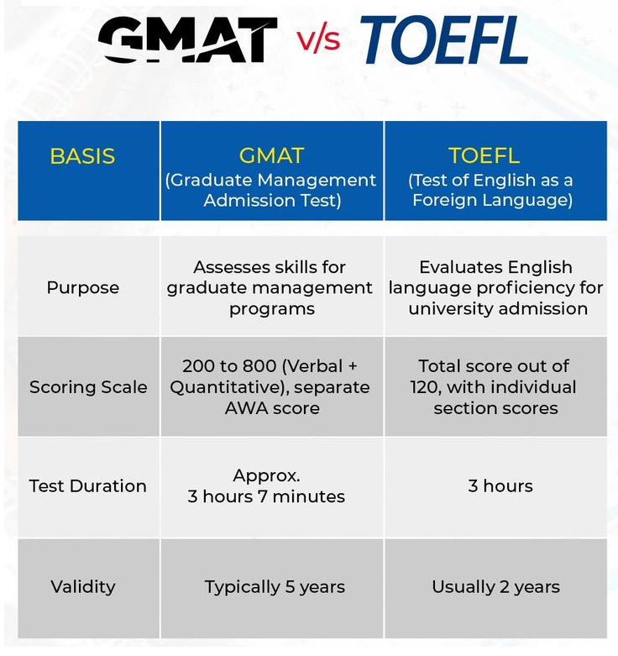

Slide 10
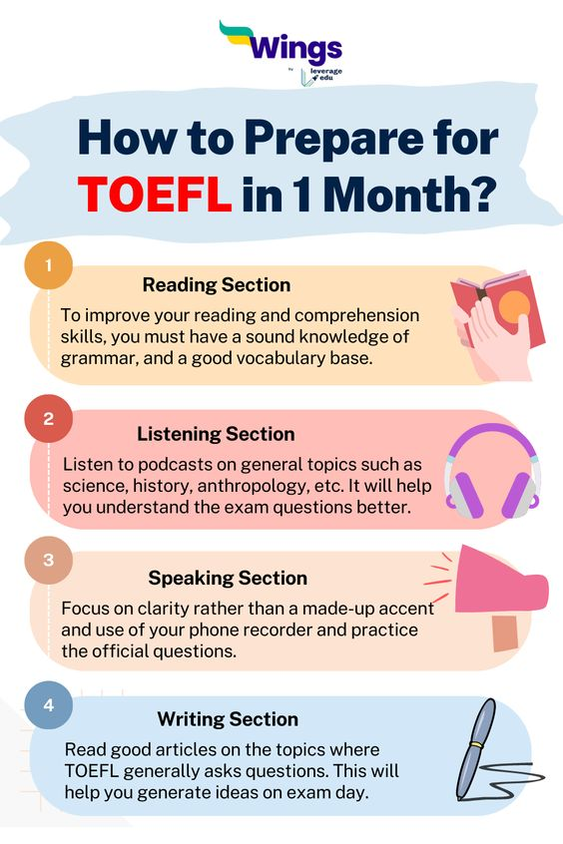

Slide 11
1. Reading (35 minutes, 20 questions): Comprehension of academic passages: You'll read academic texts on various topics like science, history, and literature, and answer questions about main ideas, details, inferences, and author's purpose. Critical thinking: Analyze information, identify assumptions and biases, and evaluate arguments presented in the passages. 2. Listening (36 minutes, 28 questions): Understanding academic lectures and conversations: Listen to academic lectures and campus discussions, and answer questions about the content, speaker's purpose, and key points. Note-taking skills: Develop and utilize notes to capture important information from the listening passages. 3. Speaking (16 minutes, 4 tasks): Independent and integrated tasks: Deliver spontaneous monologues on familiar topics, discuss academic readings and lectures, and express your opinion on a given issue. Fluency and coherence: Demonstrate clear organization, smooth transitions, and appropriate vocabulary range within your spoken responses. 4. Writing (29 minutes, 2 tasks): Integrated writing: Analyze an academic passage and lecture, then write a summary that integrates key points from both sources. Independent writing: Take a stance on an issue and develop a well-organized essay with strong arguments and supporting evidence.

Slide 12
IELTS: International English Language Testing System

Slide 13
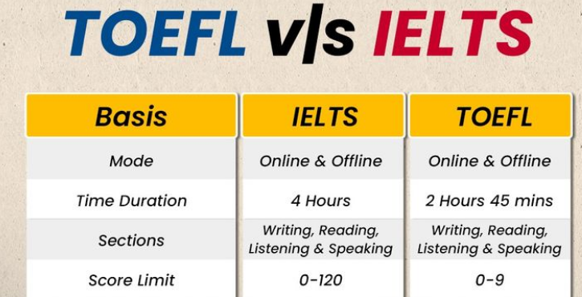

Slide 14
1. Listening (30 minutes, 40 questions): Headphones and audio waves, symbolizing listening to recorded dialogues and monologues in various settings like academic lectures, social conversations, and workplace discussions. Skills tested: Comprehension of main ideas, details, speaker's intent, and relationships between speakers. 2. Reading (60 minutes, 40 questions): Open book with academic texts, depicting reading passages on diverse topics like science, history, and literature. Skills tested: Understanding main points, supporting arguments, identifying inferences, and recognizing writer's purpose. 3. Writing (60 minutes, 2 tasks): Pen and paper on a desk, signifying writing tasks like summarizing information from a spoken text and essay writing on a given topic. Skills tested: Clarity, organization, grammar, vocabulary, and ability to develop arguments and support them with evidence. 4. Speaking (15 minutes, 3 parts): Person conversing with an examiner, illustrating a face-to-face interview with questions about personal experiences, opinions, and hypothetical situations. Skills tested: Fluency, pronunciation, vocabulary range, coherence, and ability to answer diverse questions spontaneously and thoughtfully.

Slide 15


Slide 16
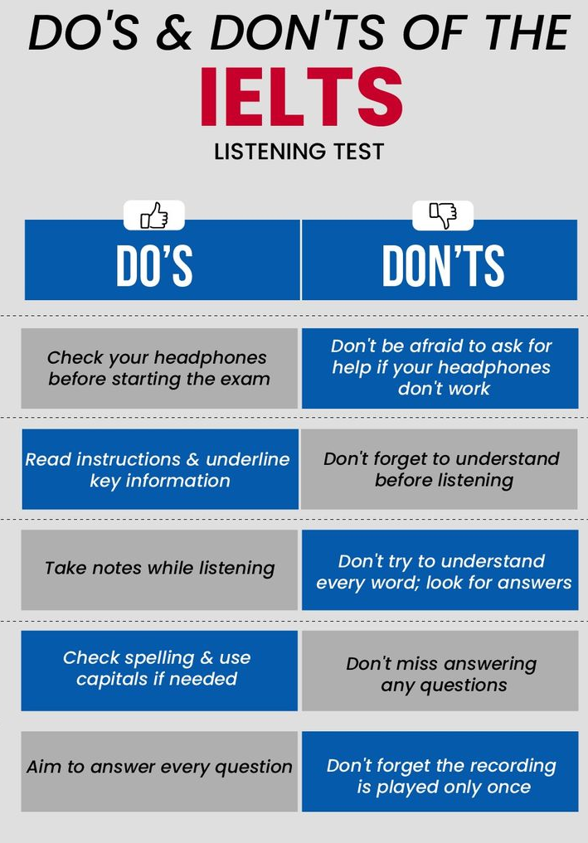

Slide 17
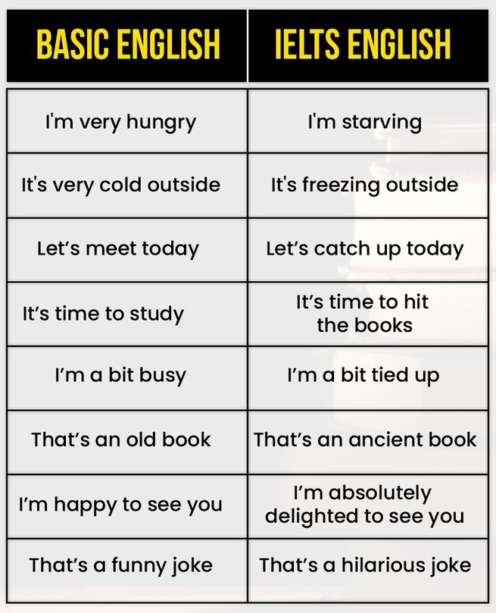

Slide 18
Thank you

